Slide 1
Introduction Operating System Operating System Zoo

Slide 2
Objectives
Operating System (OS)
The Operating System Zoo
Mainframe OS
Server OS
Multiprocessor OS
PC OS
Handheld Computer OS
Embedded OS
Sensor Node OS
Real-Time OS
Smart Card OS

Slide 3
Operating System
Context
Why do we install the Windows, or Linux, or Unix, or Macs, etc …, that is called Operating System (OS), before we want to use and control/ manipulate our computer (laptop or desktop or mobile or other devices)?
How do we manipulate the computer hardware (RAM, Disks, AGP card, Audio card, Keyboard, touch screen, etc …)?
How can our computer run or execute many programs at the time without being worried finitely RAM, one or two CPU? Do they run in parallel or in sequence order? …
How can our computer allocate the computer’s device to many running programs at the time?
What’s the OS’s role in our computer? What’s it’s main functions? Which problems do we or our computer take without the absent OS? Is the OS software or hardware?
The big question is “What is the OS?”
The important questions are
Why do we learn OS?
What constraint do between OS and SE (both IS and ES)?

Slide 4
Overview
Operating System
A computer system consists of:
User software
System software
Hardware
User Applications | Compilers | Editors | Shells
Operating System
Hardware
User mode
Software
Kernel mode (supervisor mode)

Slide 5
Operating System
Definition
A system software that acts as an intermediary between user of a computer and the computer hardware
A collection of procedures that:
Manage all the system’s hardware resources
Provide the users the environment in which they can
Use the system resources
Run their own applications
Goals
Execute user programs (mostly for ease of use with performance)
Make the hardware efficiently and convenient to use
Controls and coordinates the use of hardware among the various application programs for various users
Hides the peculiarities of disks and I/O devices

Slide 6
Operating System
Terminologies
Kernel mode
Is also called supervisor mode
OS runs in this mode
Gains control of the computer
Has complete access to all the hardware
Can execute any machine instructions
Protects the OS from errant users
User mode
The user software runs in this mode
Can execute a subset of the machine instructions with the exception of instructions to control of the machine or do I/O
The system switches between the kernel mode and user mode
If the user interacts with OS, the user mode switches to the kernel mode
If the system passes control to a user program, the kernel mode switches to the user mode

Slide 7
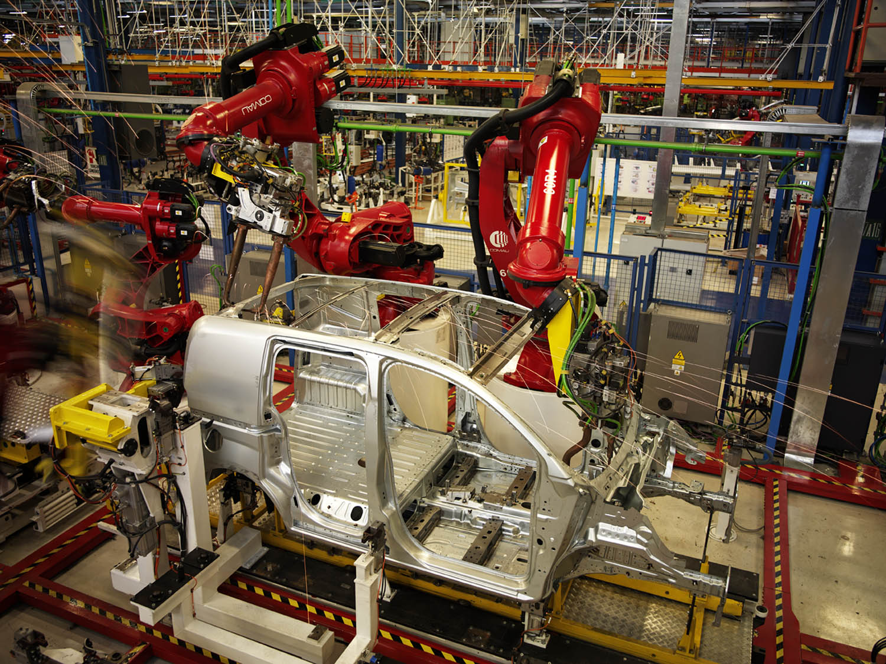
The Operating System Zoo
Mainframe OS
Are heavily oriented toward processing many jobs at once, most of which need prodigious amounts of I/O
Offers 3 kinds of services
Batch
Ex: car assembly lines
Runs one and only one application
Process routine job without interactive user present
The OS always residents in memory and transfer control automatically from one job to the next in the sequence requested jobs
CPU is often idle, all jobs are kept on a disk

Slide 8
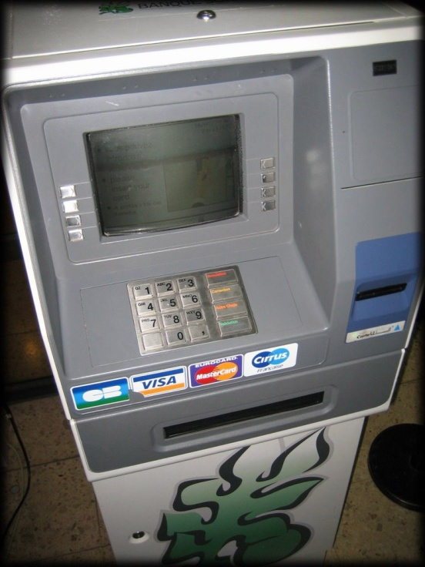
The Operating System Zoo
Mainframe OS
Are heavily oriented toward processing many jobs at once, most of which need prodigious amounts of I/O
Offers 3 kinds of services
Transaction processing
Ex: ATM banking
Handle large numbers of small requests
A single unit of work that consists of one or more operations that are interconnected
Series of operations are All or None
Timesharing (multitasking)
Ex: Google Search Server (Interactive System)
Allow multiple remote users to run jobs on the computer at once
Each user has at least one separate program in memory
OS/390 and OS/360, then they’re gradually being replaced by UNIX variants such as Linux

Slide 9
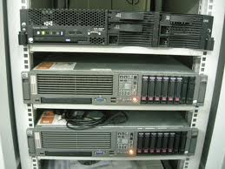
The Operating System Zoo
Server OS
Runs on Server (PC, workstation, or mainframe)
Serves multiple users at once over a network and allow the users to share hardware and software resources
Servers can assume particular task on different server (machine) as web, mail, application, file, firewall, CA – Certificated authentication, etc …
UNIX, Windows NT, Windows 2K (2000, 2003, 2008), Linux, Fedora Core, Ubuntu, Solaris ...

Slide 10
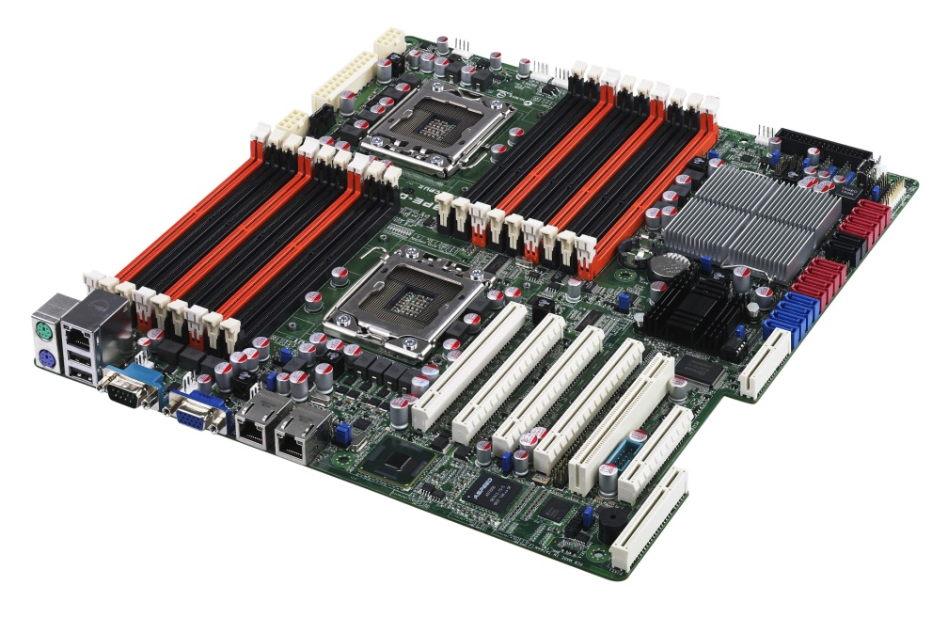
The Operating System Zoo
Multiprocessor OS
Is known parallel systems
Runs on systems that have many CPUs (multi-processors, multi-cores, multi-chips)
Many processors communicate in close, share the computer bus, the clock, and sometimes memory and peripheral devices
Increased throughput
Saving (share peripherals mass storage, …)
Increased reliability (not halt system, sharing the work with other processors)
Windows, Linux, SunOS (Solaris), UNIX, OS/2 …

Slide 11
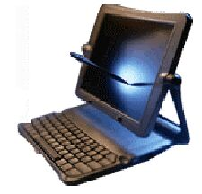
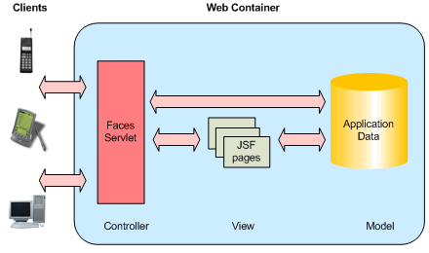
The Operating System Zoo
Personal Computer OS
Supports multiprogramming
Good supports to a single user (thus, it has become popular nowadays)
Optimizes for maximizing user convenience and responsiveness
Are used for word processing, spreadsheets, Internet access …
Windows 98, Windows ME, Windows XP, Windows Vista, Windows 7, Macintosh, Linux, Fedora Core, Ubuntu ...

Slide 12


The Operating System Zoo
Handheld Computer OS
Supports a small computer as handheld or PDA (Personal Digital Assistant), mobile (cellular) phones, smart phones.
Is used with small memory, slow processors, small display screen
Are increasingly sophisticated, with the ability to handle telephony, digital photography, …
Can only run single application
Today, some handheld OS (smart phone) can run multiple program (e.g. Windows Mobile version ≥ 6, Symbian ≥ 7, Mac, Android, iOS, …)
Symbian, Palm, Windows Phone, Windows CE, Android, iOS…

Slide 13
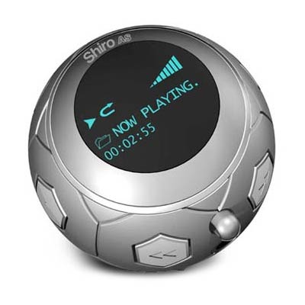
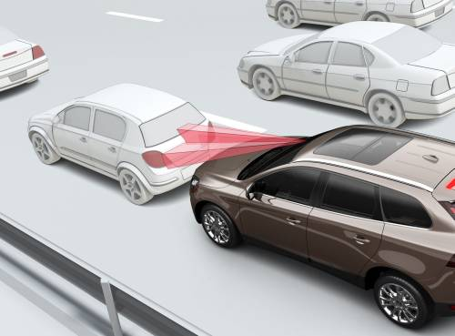
The Operating System Zoo
Embedded OS
Insides electronic devices such as microware ovens, TV, cars, DVD, cellular phones, MP3 player, recorder …
Is tailored for its specific applications
Runs a limited number of programs, known at design time
It may be possible to make optimizations not possible in general purpose systems
There is no need for protection between applications
Is located in ROM
VxWorks, QNX

Slide 14
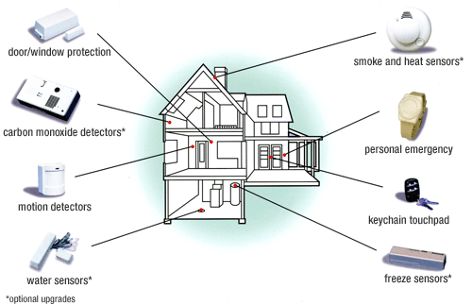
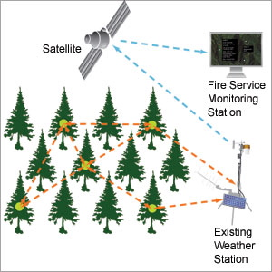
The Operating System Zoo
Sensor Node OS
Supports sensor node
Each sensor node is a real computer with CPU, RAM, ROM, and one or more environmental sensors
Usually one that is event driven, responding to external events or making measurements periodically based on an internal clock
Ex: on camera secure the building, forecast or predict environments (weather, fires, temperatures …)
Small size, using low power
Is dependent on battery
TinyOS

Slide 15
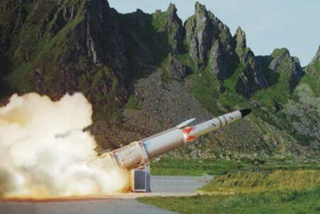
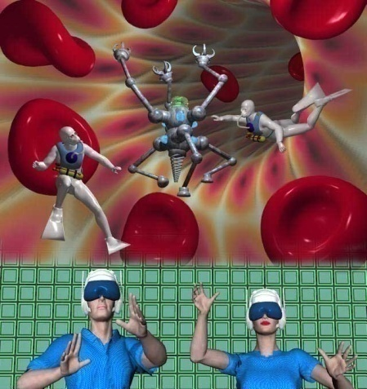
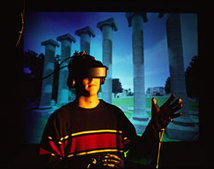
The Operating System Zoo
Real-Time OS
Time is important, and the hard deadlines must be met
Supports real-time system as industrial robots, assembly line, digital telephones
2 types
Hard real-time system
Provides absolute guarantee certain time
Ex: military, avionics, …
Soft real-time system
Can miss deadline (that does not cause permanent damage)
Ex: digital telephones, multimedia systems, real virtual
eCos

Slide 16
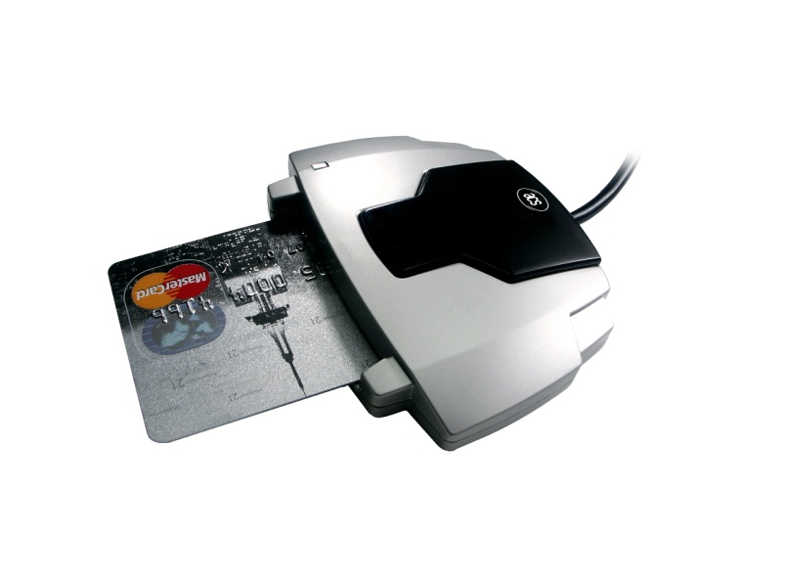
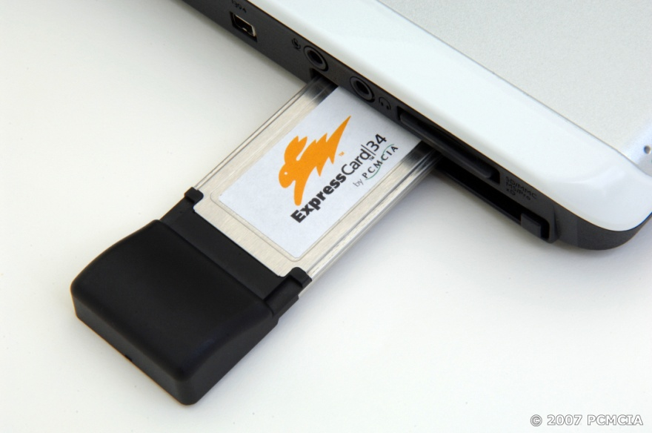
The Operating System Zoo
Smart Card OS
Ex: credit card, ATM, Wireless LAN Card Bus Card, …
Runs on smart cards (with better security and universality)
Have very severe processing power and memory constraints
Can handle electronic payments, presenting Java applets

Slide 17
Summary
Operating System
Operating Systems
Q&A

Slide 18
Next Lecture
Operating System Concepts
process, address space, file , io, …
System Calls

